Slide 1
Software Architecture Assignment 2(SEZG651/SSZG653)
SAQUIB
2021MT12266@wilp.bits-pilani.ac.in

Slide 2
Purpose of the System
Currently XYZ service provider having separate login for multiple XYZ service applications, XYZ partner app and XYZ web portal.
Requirement is to implement single sign on and two factor login authentication for all the XYZ service so that user can login to all XYZ application ,XYZ partner app, XYZ web portal to the single id and password.
Enable users for 2 factor authentication for XYZ partner app.
Enable authentication and Single sign in to XYZ service application.
Enable authentication and Single sign on to XYZ web portal.

Slide 3
Key Requirements : Functional & Non-Functional
Functional requirements | Non functional requirements
A user data must be secure and must not be leaked to an outsider, while user entering the login information , it should not be hacked or breach in any way. Only valid login should be allowed to enter in the system The data entered by user should be accurate based on details end user should view the module of the application. User need to enter login email, mobile number username and OTP password if required to login the XYZ services. System must allow to reset the password by clicking the “Reset Password” and receiving a link to their email address. Password should be combination of 8 character long, No space, Upper Case, Lower Case, Numeric and Special character | Performance: System should be able to support y number of users on the big billion sales Time taken to view the UI page after login should not be more than t seconds. Navigation form one page to other page should not take more x seconds. Availability The system should be completely operational at least 95%of the time. Downtime of the system should not exceed 1hr Modifiability System should be able to integrate new products without major re-work. Interoperability ABC website portal should be viewable to chrome, ff, safari, android and IOS platform Security Customer sensitive data stored in encrypted format

Slide 4
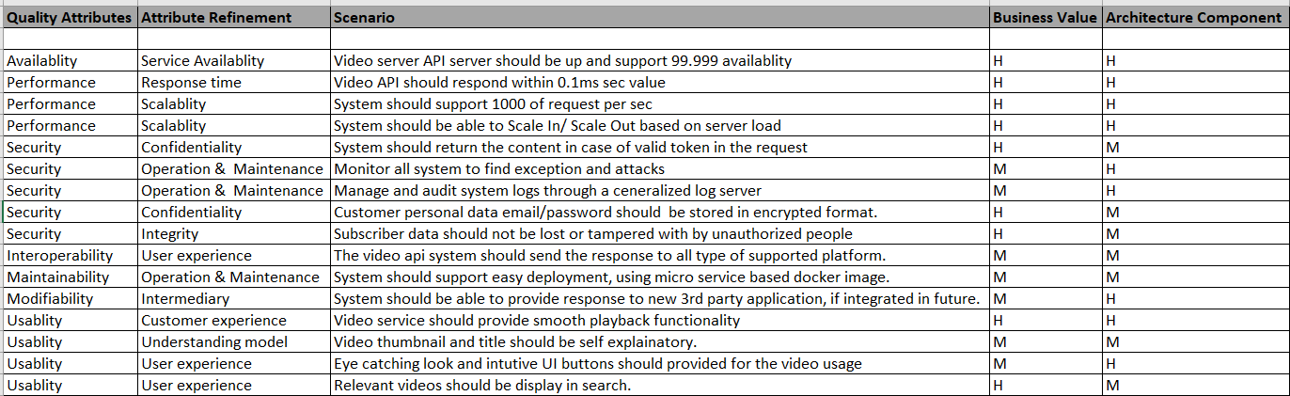
Utility Tree

Slide 5
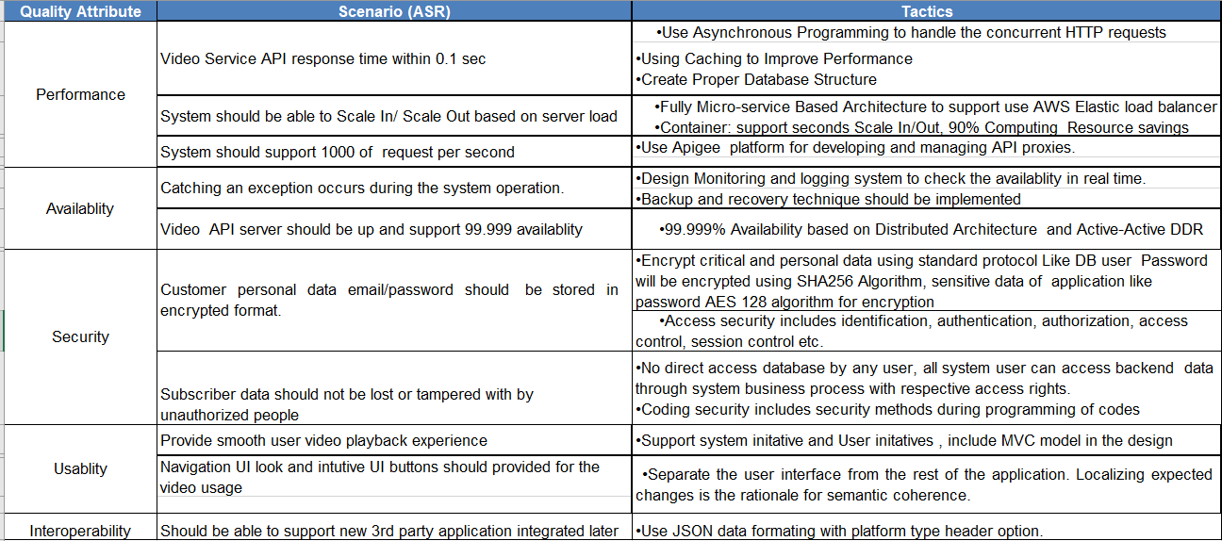
Tactics used to achieve the top 5 ASRs

Slide 6
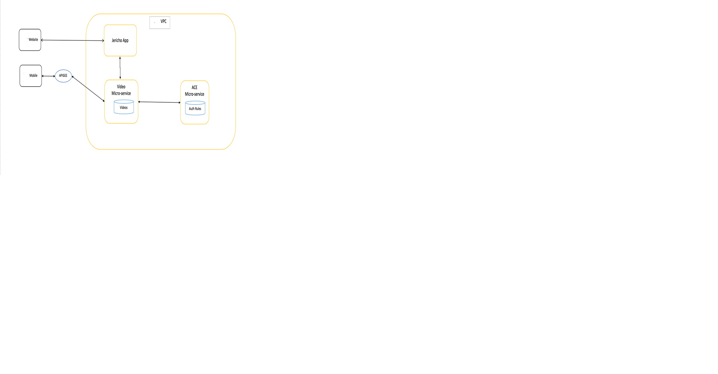
Context Diagram

Slide 7
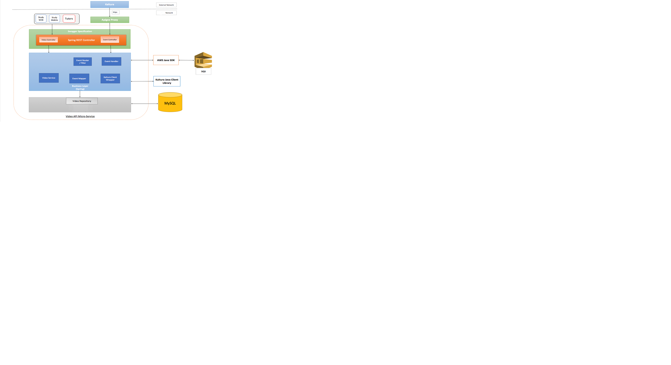
Module Decomposition Diagram

Slide 8
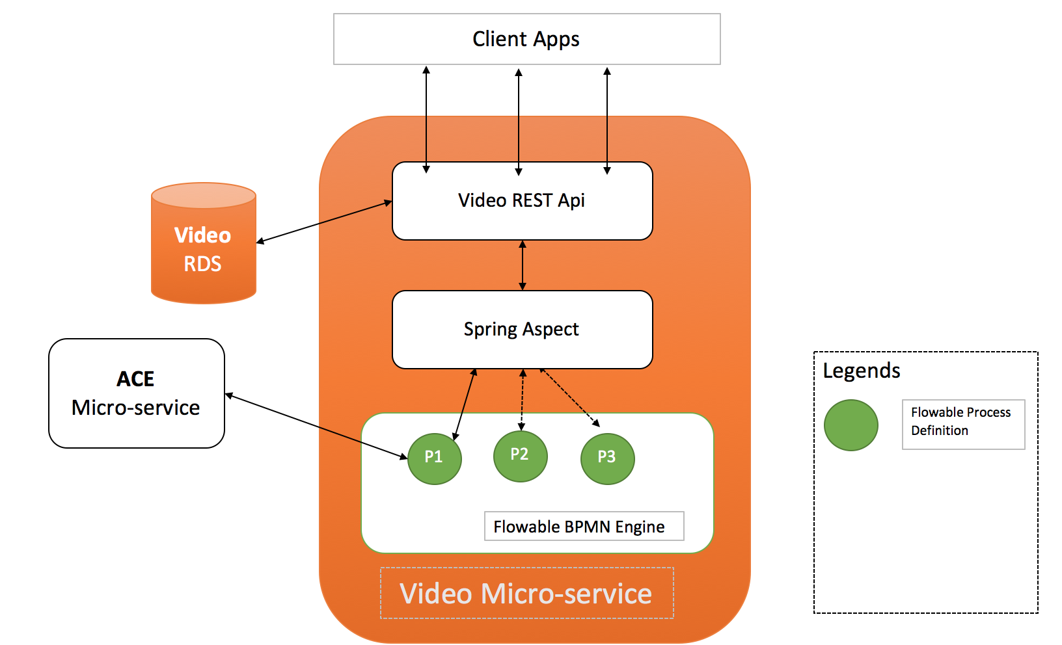
Component and Connector Diagram

Slide 9
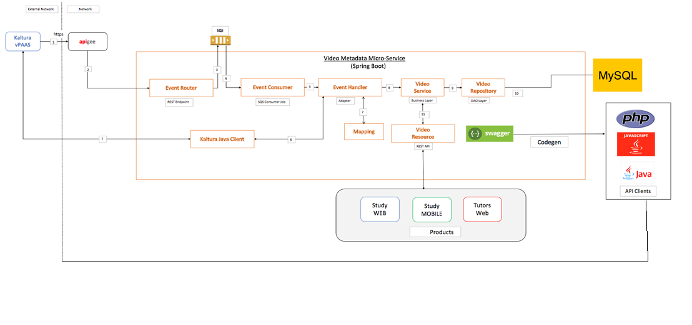
Deployment Diagram

Slide 10
System Working
Kaltura would post events for newly published videos to APIGEE proxy layer(https) with authentication key in header and event object in payload.
APIGEE will forward events to Event Router which is a REST endpoint that accepts event object in JSON format.
Event router will publish the events received as is to an Amazon SQS Queue. Before publishing, event router will apply filtering logic to filter out events based on business use case.
Event consumer will poll the Amazon SQS Queue for events.
Event consumer will forward events received from Amazon SQS Queue to Event handler which will parse the event based upon the type of event.
Event handler will retrieve custom metadata information from Kaltura using Kaltura's Java Client library.

Slide 11
System Working
Event handler will transform the custom metadata information of video into Video-Metadata Micro-service object model based upon mapping rules.
Event handler will then forward the video metadata object to business layer for persisting metadata object.
Business/Service layer will apply any business validations and pass the metadata object to repository layer.
Video repository will persist the metadata object into MySQL data store.
Video resource would provide access to video-metadata stored in MySQL data store over REST API. The REST API could be used by various ABC.co products.

Slide 12
Key Learnings
Personally , I got the basic idea about what is utility tree and how to create it.
Got the idea of how Availability, modifiability, Performance, Security scenario tactics used practically.
Identify different type of diagram like context, module, deployment diagram etc.
On personal experience, If the architecture is properly design , it help us to understand the project easily and enable to speed up the development activities.
It help us to see the reduce the risk factors, analyze the cost of the project ,and identify other critical requirement which might be overlooked if the architecture not design properly.
By designing proper architecture, all quality attributes can be taken care which led us to deliver customer centric, aligned with business requirement project.

Slide 13
THANK YOU

